Slide 1

AI IN RECOGNITION- HAND GESTURE RECOGNITION
Presented by:
Siddamsetti. Revanth Gupta
Esha
Kashinath Tiwari

Slide 2
TABLE OF CONTENT
Introduction
How AI Hand Gesture Recognition Works
Applications of AI Hand Gesture Recognition
Applications in Gaming
Applications in Healthcare
Applications in Industrial Automation
Current State of the Art
Challenges and Limitations of AI Hand Gesture Recognition
Future of AI Hand Gesture Recognition
Conclusion

Slide 3
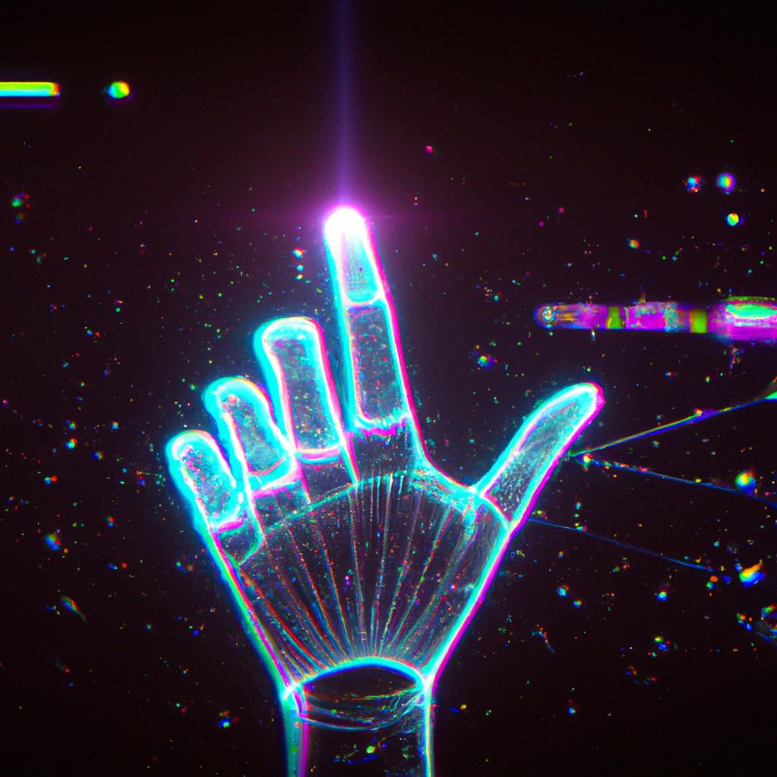
INTRODUCTION - By Esha
Artificial intelligence (AI) revolutionizing the way we interact with technology, and hand gesture recognition is one of its most exciting applications. With the ability to interpret human hand movements, AI can enable touch-free control of devices, improve accessibility for people with disabilities, and enhance virtual and augmented reality experiences.
In this presentation, we will explore the latest developments in AI-powered hand gesture recognition technology and its potential impact on various industries and fields.

Slide 4
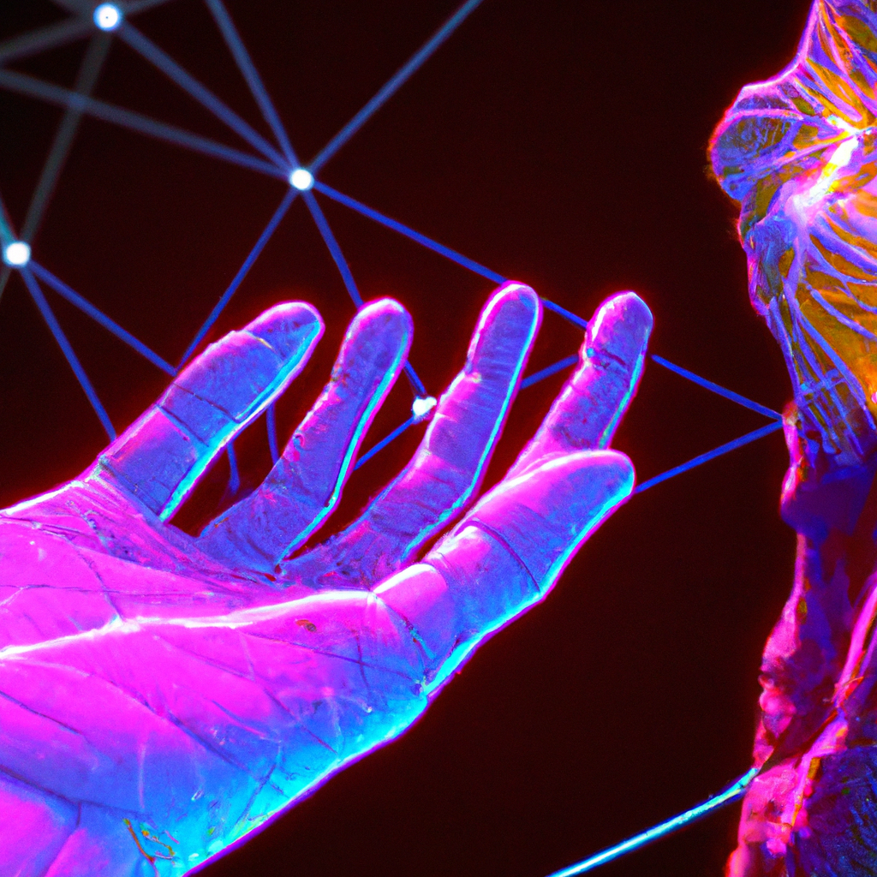
How AI Hand Gesture Recognition Works
AI hand gesture recognition technology uses computer vision algorithms to analyze and interpret the movement of hands in real-time. The system captures video data from a camera or sensor and processes it using deep learning models to identify specific gestures and actions.
The AI model is trained on a large dataset of hand gesture images and videos, which allows it to recognize different hand shapes, poses, and movements with high accuracy. The system can also learn and adapt to new gestures based on user feedback and input.

Slide 5
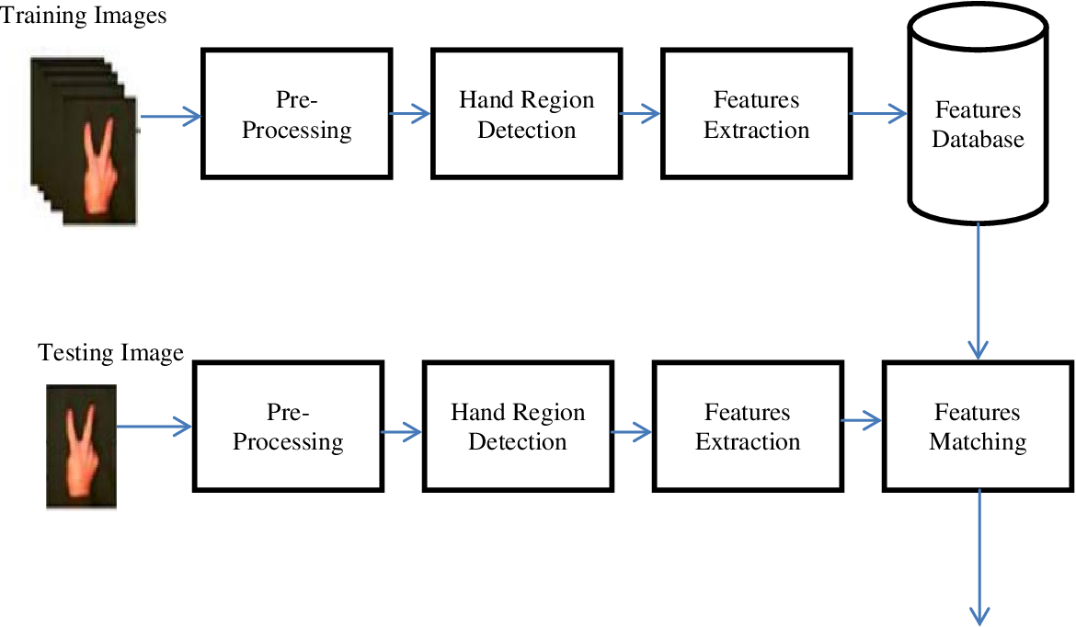
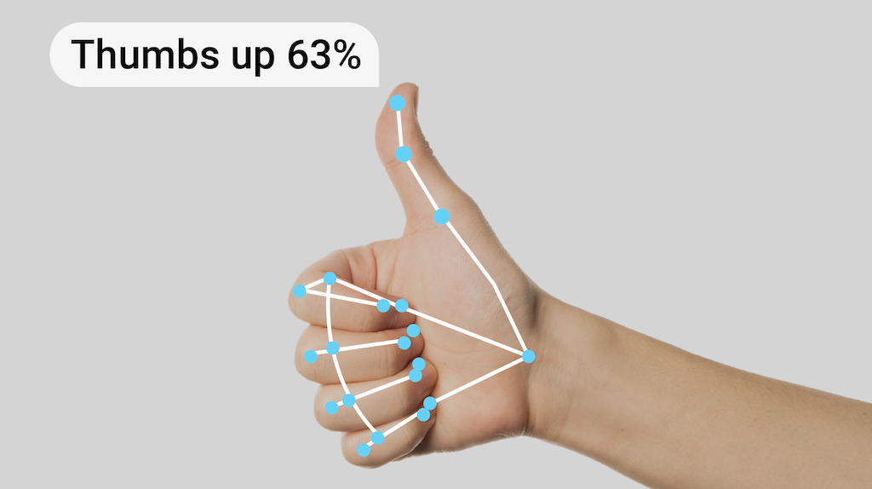
.

Slide 6
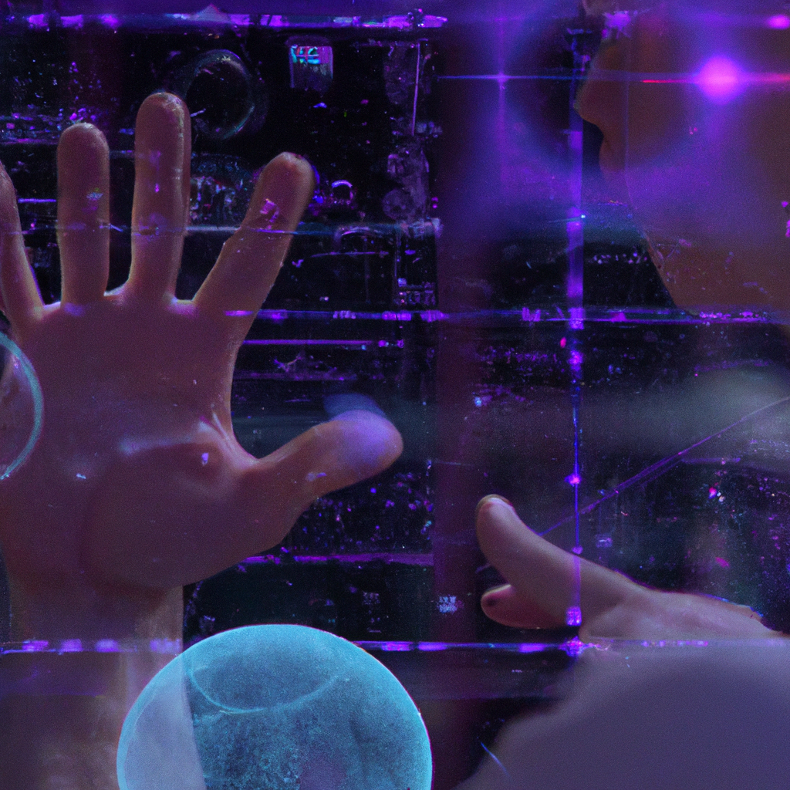
Applications of AI Hand Gesture Recognition - By Kashinath Tiwari
AI hand gesture recognition has numerous applications across various industries and fields. In healthcare, it can be used to control medical equipment without touching it, reducing the risk of infection transmission. In automotive manufacturing, it can improve worker safety by enabling touch-free control of machinery. In gaming and entertainment, it can enhance the immersive experience by allowing users to interact with virtual environments using natural hand gestures.
Moreover, AI hand gesture recognition can benefit people with disabilities by providing them with a more accessible way to control devices and communicate with others. It can also be used in security systems to detect suspicious behavior and prevent crimes.

Slide 7
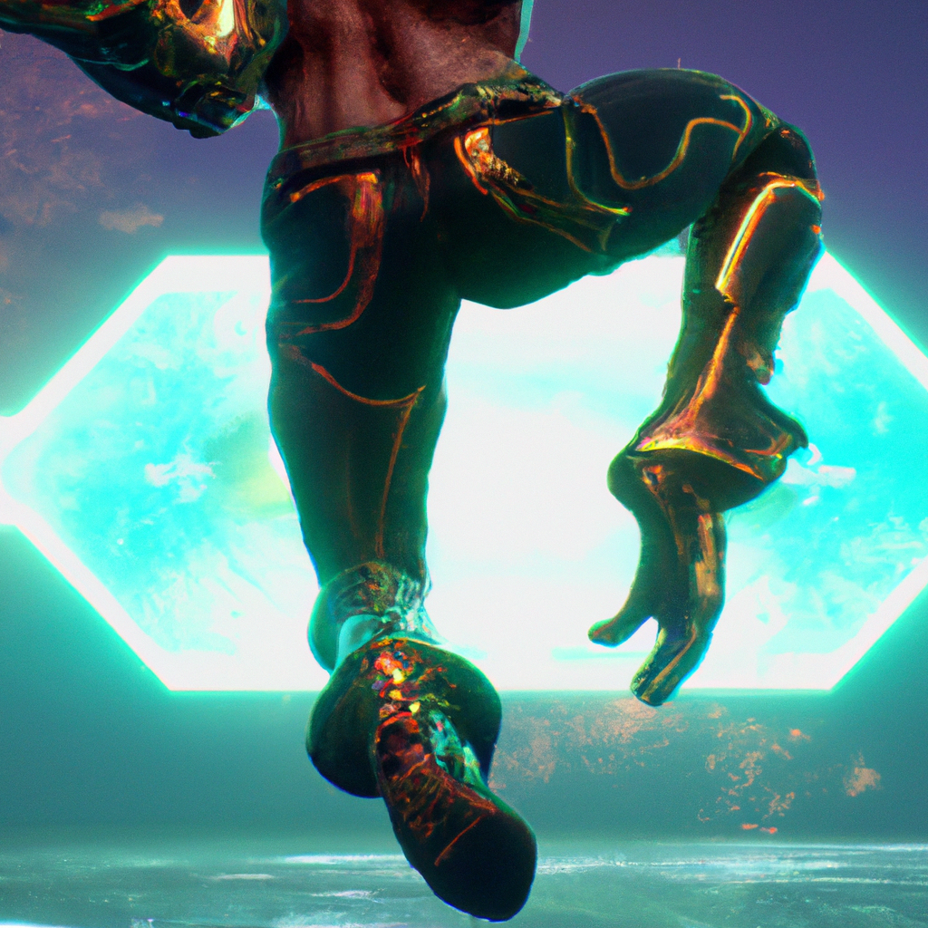
Applications in Gaming
One of the most exciting applications of hand gesture recognition is in gaming. By using hand gestures instead of traditional controllers, players can enjoy a more immersive and intuitive gaming experience.
For example, a player might make a throwing motion to launch a projectile, or a punching motion to perform a melee attack. This not only makes games more fun, but also provides a new level of accessibility for gamers with disabilities.

Slide 8
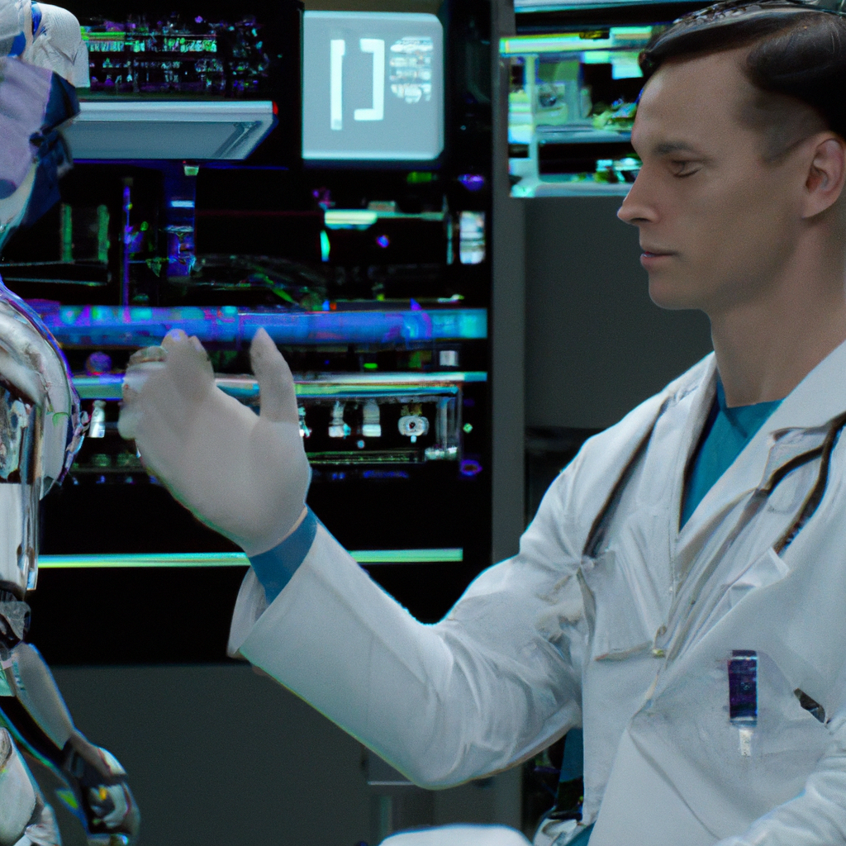
Applications in Healthcare
Hand gesture recognition also has important applications in healthcare. For example, doctors and nurses could use it to control medical equipment without having to touch it, reducing the risk of infection.
Additionally, patients with disabilities or injuries could use hand gestures to communicate with caregivers or control their environment, improving their quality of life and independence.

Slide 9
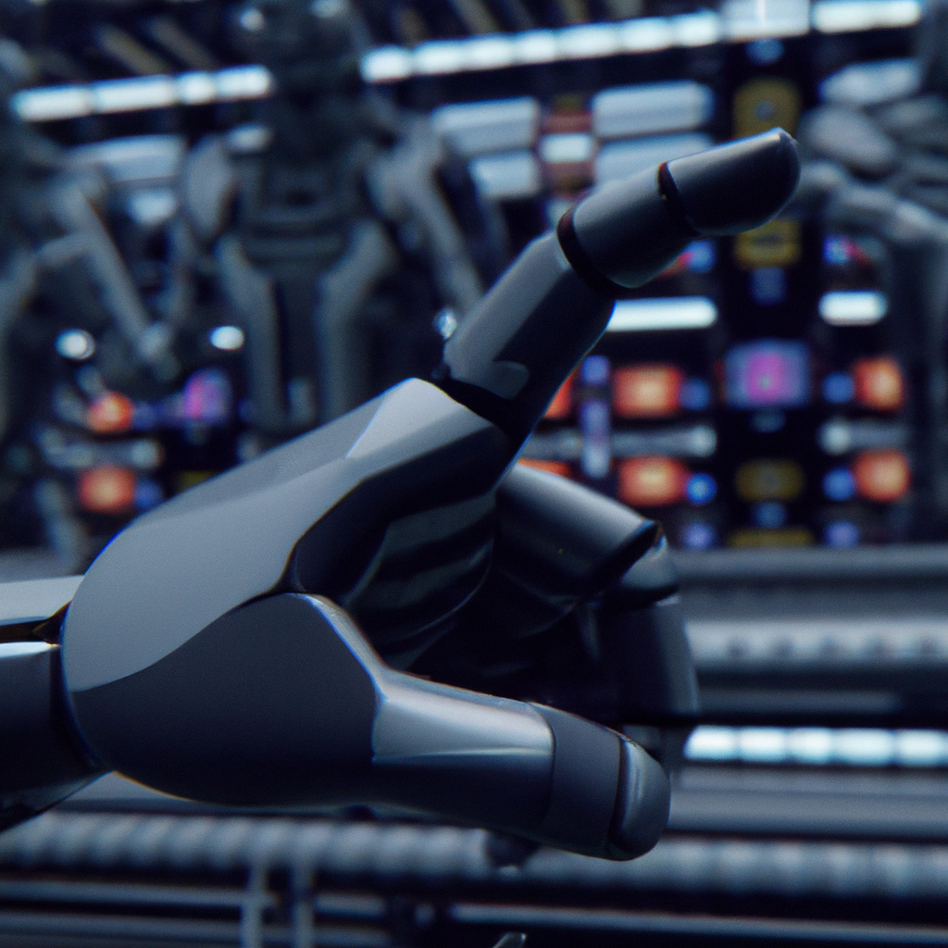
Applications in Industrial Automation
Hand gesture recognition can also be used in industrial automation settings, where workers need to control machinery or equipment from a distance.
For example, a worker might use hand gestures to adjust the speed of a conveyor belt or activate a robotic arm. This not only improves safety by reducing the need for physical contact with machines, but also increases efficiency by allowing workers to control multiple devices at once.

Slide 10
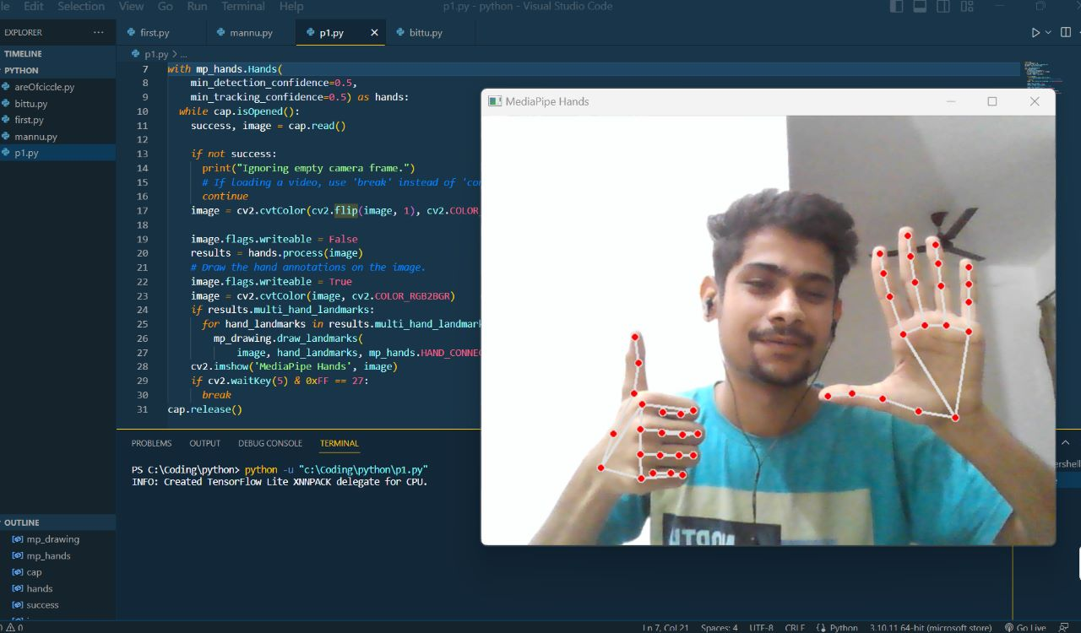

Slide 11
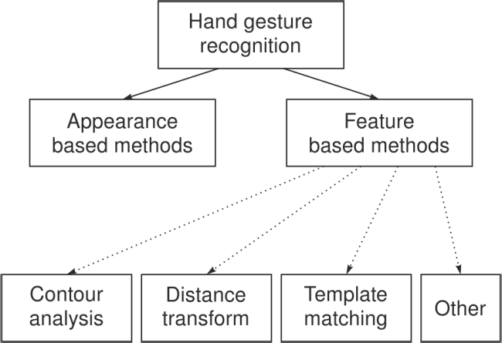

Slide 12
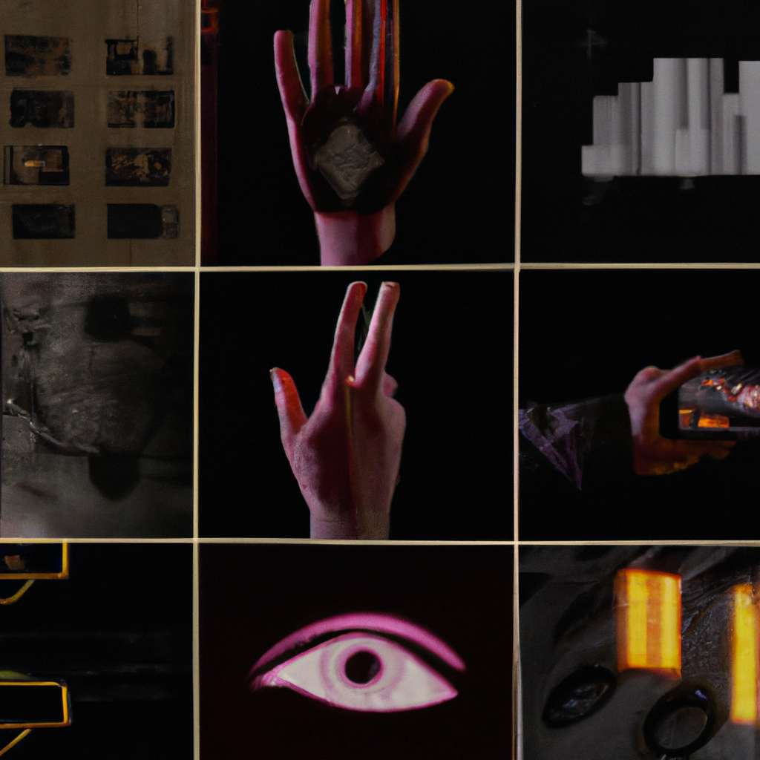
Recent advances in machine learning and computer vision have led to significant improvements in hand gesture recognition technology. Some of the most promising approaches involve combining multiple sensors and modalities, such as cameras and depth sensors, to improve accuracy and robustness.
Current State of the Art
- By Siddamsetti. Revanth Gupta

Slide 13
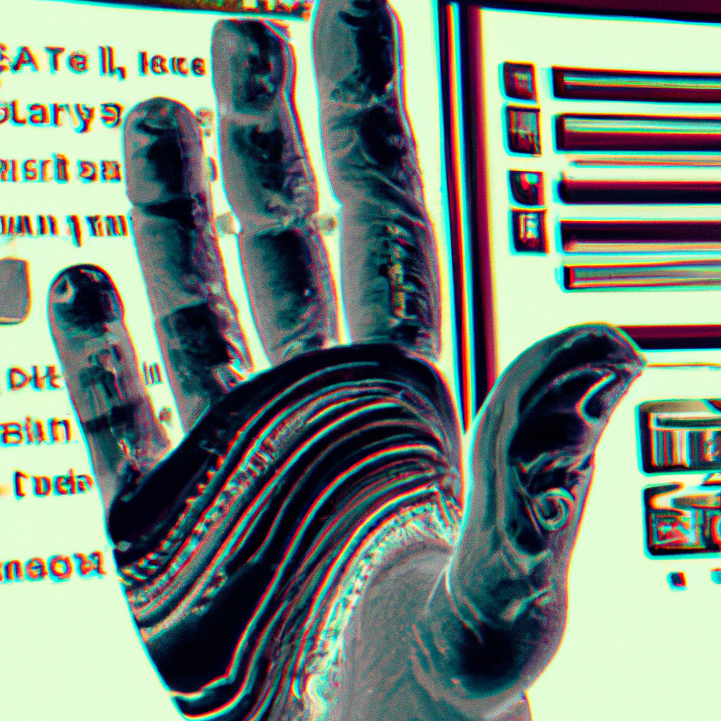
Challenges and Limitations of AI Hand Gesture Recognition
Despite its potential benefits, AI hand gesture recognition technology still faces several challenges and limitations. One of the main issues is the need for high-quality sensors and cameras that can capture accurate and detailed hand movements. The system also requires significant computing power to process the data in real-time.
Another challenge is the potential for bias and errors in the AI model, which can lead to incorrect interpretations of hand gestures and actions. This can have serious consequences in applications such as healthcare and security. Additionally, the system may struggle to recognize gestures made by people with unique hand shapes or disabilities.

Slide 14
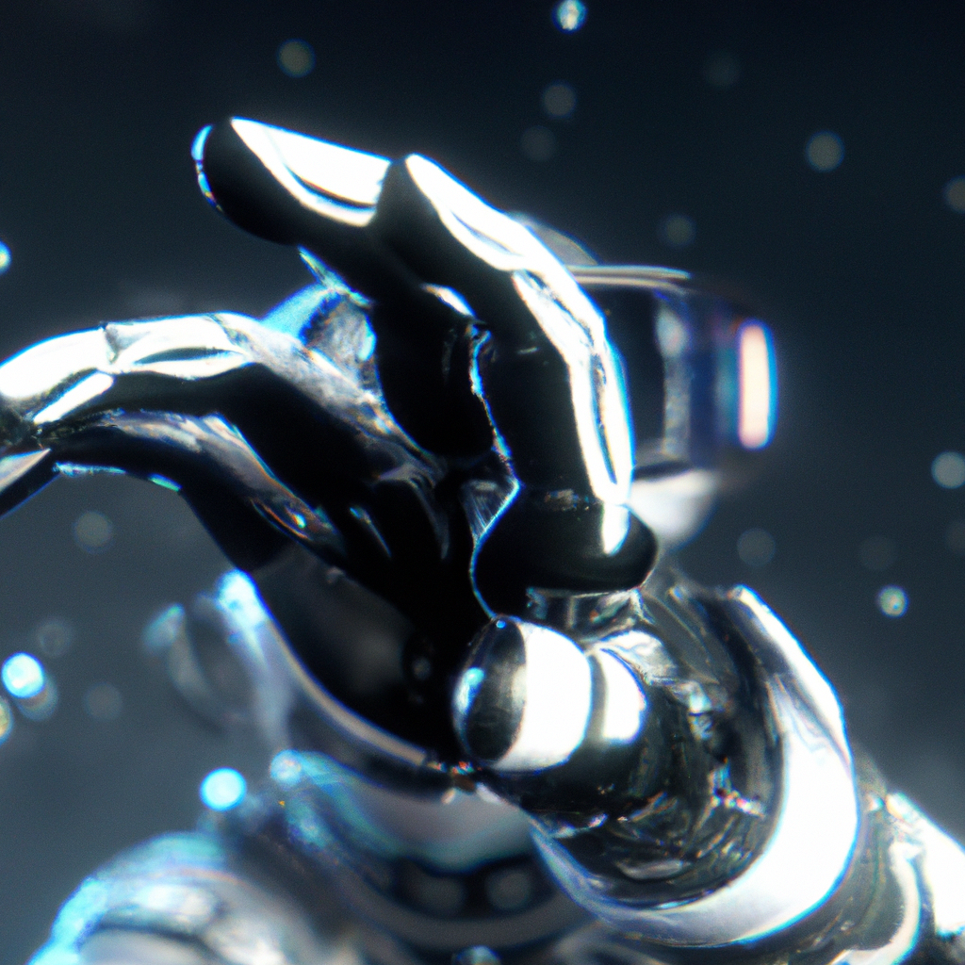
Future of AI Hand Gesture Recognition
Despite its current limitations, the future of AI hand gesture recognition looks promising. As technology continues to advance, we can expect to see more accurate and reliable systems that can interpret a wider range of hand gestures and movements. With the increasing demand for touch-free control and accessibility, AI hand gesture recognition is likely to become a ubiquitous technology in various industries and fields.
Moreover, the integration of AI hand gesture recognition with other technologies such as virtual and augmented reality can create entirely new possibilities for human-computer interaction and communication.

Slide 15
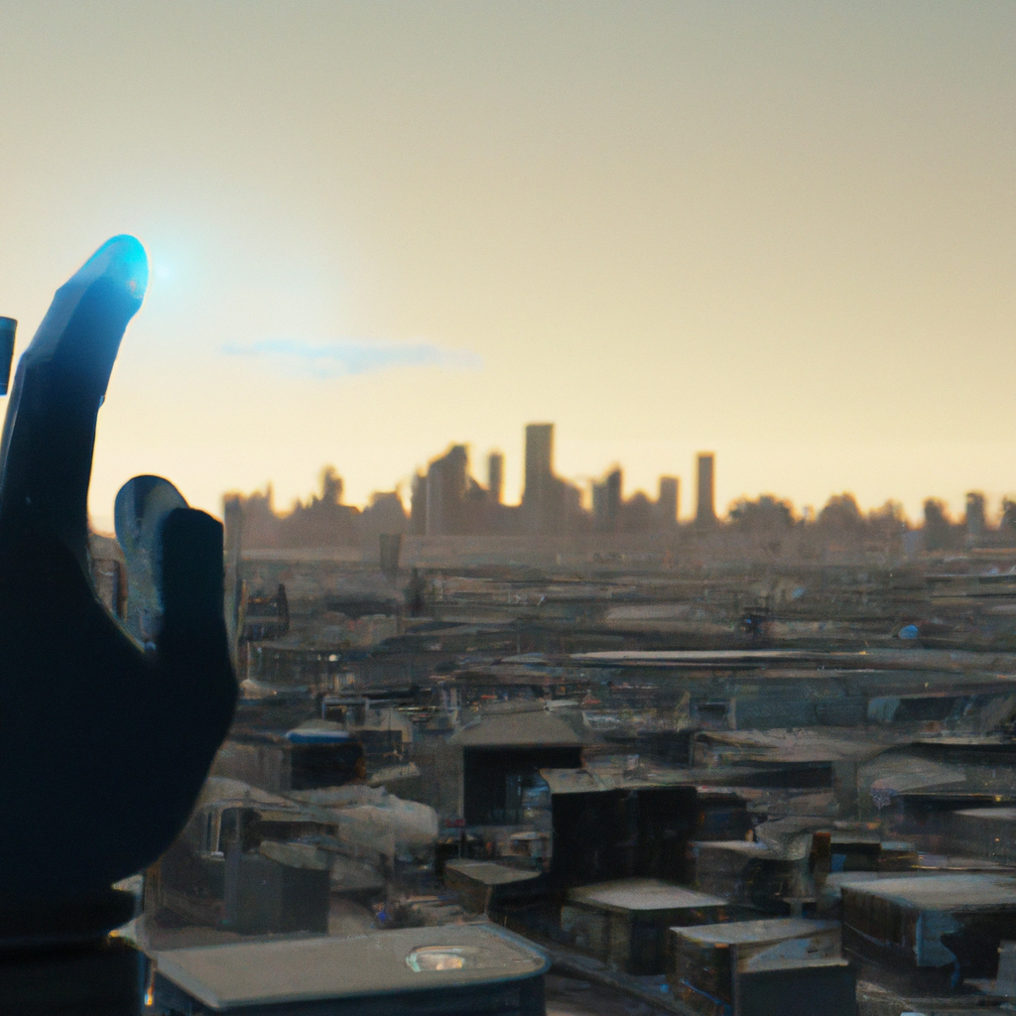
Conclusion
In conclusion, AI hand gesture recognition is a fascinating technology with immense potential to transform the way we interact with devices and machines. Its applications are diverse and far-reaching, from healthcare to gaming. While there are still challenges and limitations to overcome, the future of AI hand gesture recognition looks bright, and we can expect to see more innovative and exciting developments in the coming years.
As we continue to push the boundaries of what is possible with AI, we must also ensure that the technology is developed responsibly and ethically, with considerations for privacy, security, and inclusivity.

Slide 16
REFERENCE:
.
https://www.geeksforgeeks.org/project-idea-dynamic-hand-gesturerecognition-using-neural-network/
https://www.javatpoint.com/hand-gesture-controlled-robot
https://www.researchgate.net/publication/284626785_Hand_Gesture_Recognition_A_Literature_Review

